Slide 1


Einführung in K-Nearest Neighbors (KNN)
Huseyn Abdullayev
Notes:
Zum Wechsel des Titelbildes: Bild auswählen > Bildformat (Oben in Menüleiste) > Bild ändern > Neues Bild auswählen

Slide 2
Agenda
KNN Classification
KNN regression

Slide 3
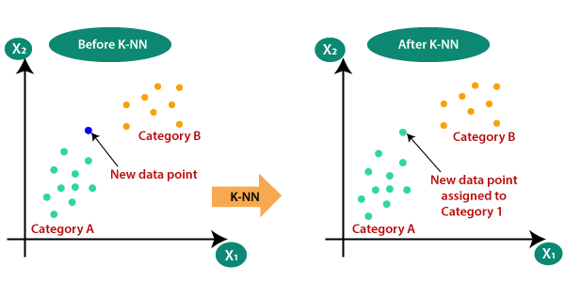
KNN
KNN is one of the simplest machine learning algorithms for classification and regression
It is based on the intuitive idea that similar things exist in close proximity.
Think of it like looking for a restaurant. You'll likely choose a place that's similar to your favorite ones and is nearby.
Source :https://medium.com/swlh/k-nearest-neighbor-ca2593d7a3c4

Slide 4
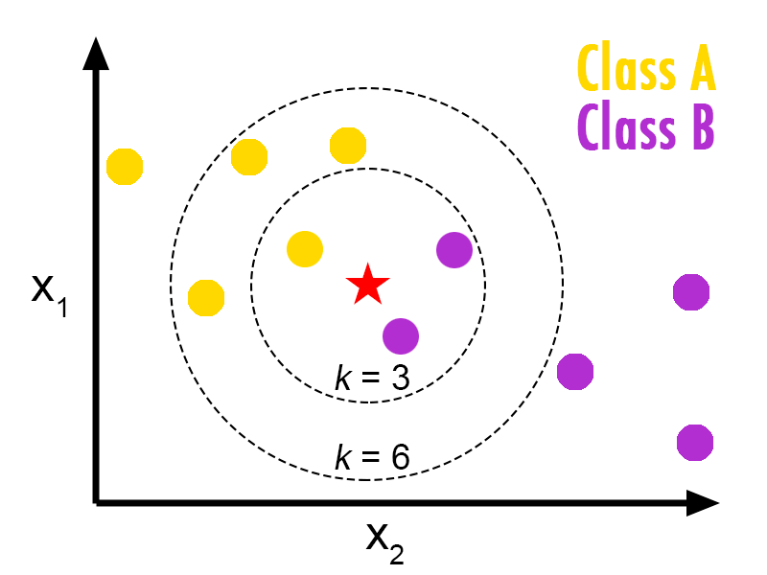
KNN Classification
KNN works by comparing a new, unknown item to the nearest items from a dataset.
The 'K' in KNN stands for the number of neighbors you consider.
For example, if K=3, the algorithm looks at the three nearest neighbors to decide the category of the new item.
When K = 3, the new data point belongs to class A; however, when K = 6, the new data point belongs to class B.
Source :https://medium.com/@bengikoseoglu/why-log-loss-metric-shouldnt-be-used-to-evaluate-nearest-neighbour-classification-1fe314f460a2

Slide 5
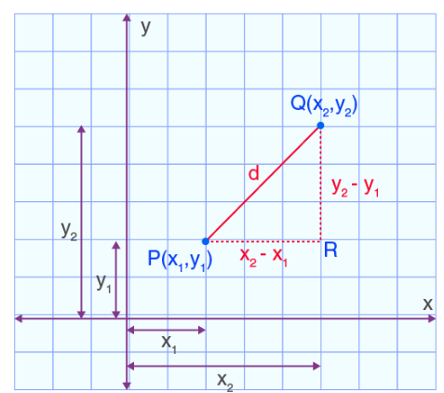
KNN regression
Euclidean Distance:
Distance metrics
Euclidean Distance:
Manhattan Distance
Minkowski Distance
KNN's performance is highly sensitive to the scale of data because distance metrics are influenced by the magnitude of the features.
Different features can have different scales (e.g., height in centimeters and weight in kilograms).
Before applying KNN, it's essential to normalize or standardize the data so that each feature contributes equally to the distance calculations.
Normalization typically means scaling features to a range of [0, 1], while Standardization transforms data to have a mean of 0 and a standard deviation of 1.
Source :https://byjus.com/maths/euclidean-distance/

Slide 6
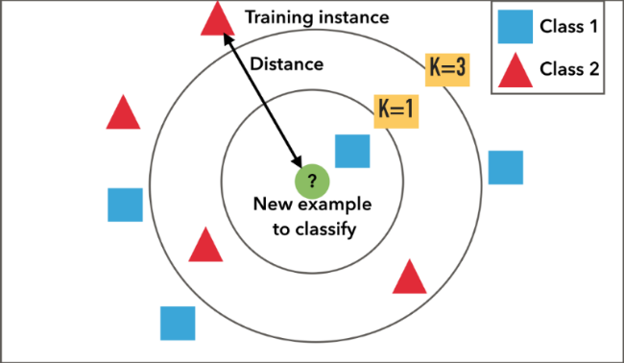
Pros and Cons of KNN
Pros:
Simple and easy to implement.
No need to build a model, tune several parameters, or make additional assumptions.
The algorithm is versatile. It can be used for classification, regression, and search.
Cons:
Computationally expensive because it requires distance calculations for each instance.
Not ideal for large datasets or datasets with many features.
Sensitive to the scale of data and irrelevant features.
Source :https://medium.com/@anuuz.soni/advantages-and-disadvantages-of-knn-ee06599b9336

Slide 7



